Slide 1
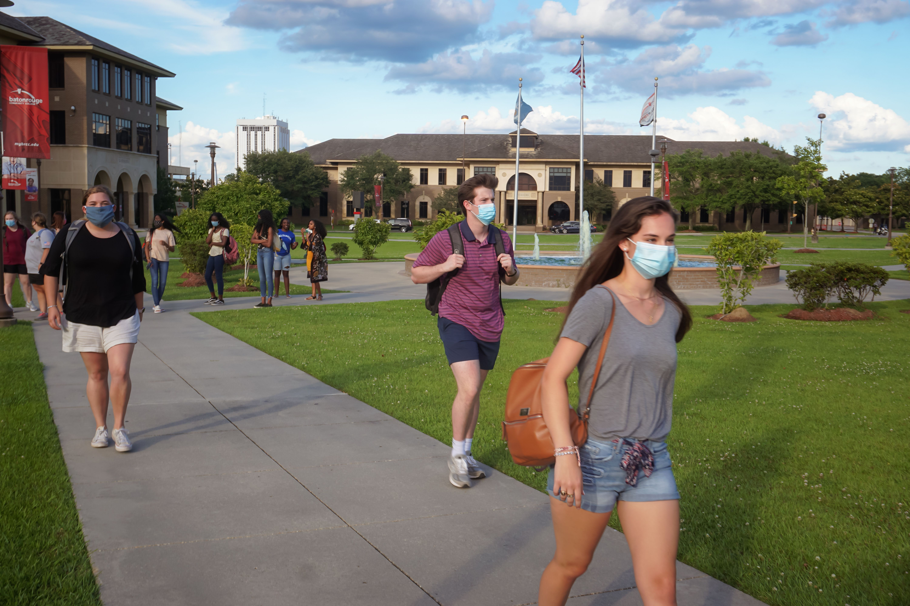
AGENDA ITEM 5.2
Report on Reopening Postsecondary Education
Campuses Focused on Safe Reopening
Fall Reopening Start Dates
- 4-year institutions – Aug. 5-24, 2020
- 2-year institutions – Aug. 10-24, 2020
- LAICU institutions – Aug. 10-24, 2020
Fall End Dates
- 4-year institutions – Nov. 22-Dec. 24, 2020
- 2-year institutions – Nov. 30-Dec. 18, 2020
- LAICU institutions – Nov. 14-Dec. 18, 2020
Major Calendar Changes
- Start semester one week early
- No Fall Break
- No on-campus interaction after Thanksgiving; online final exams

Slide 2
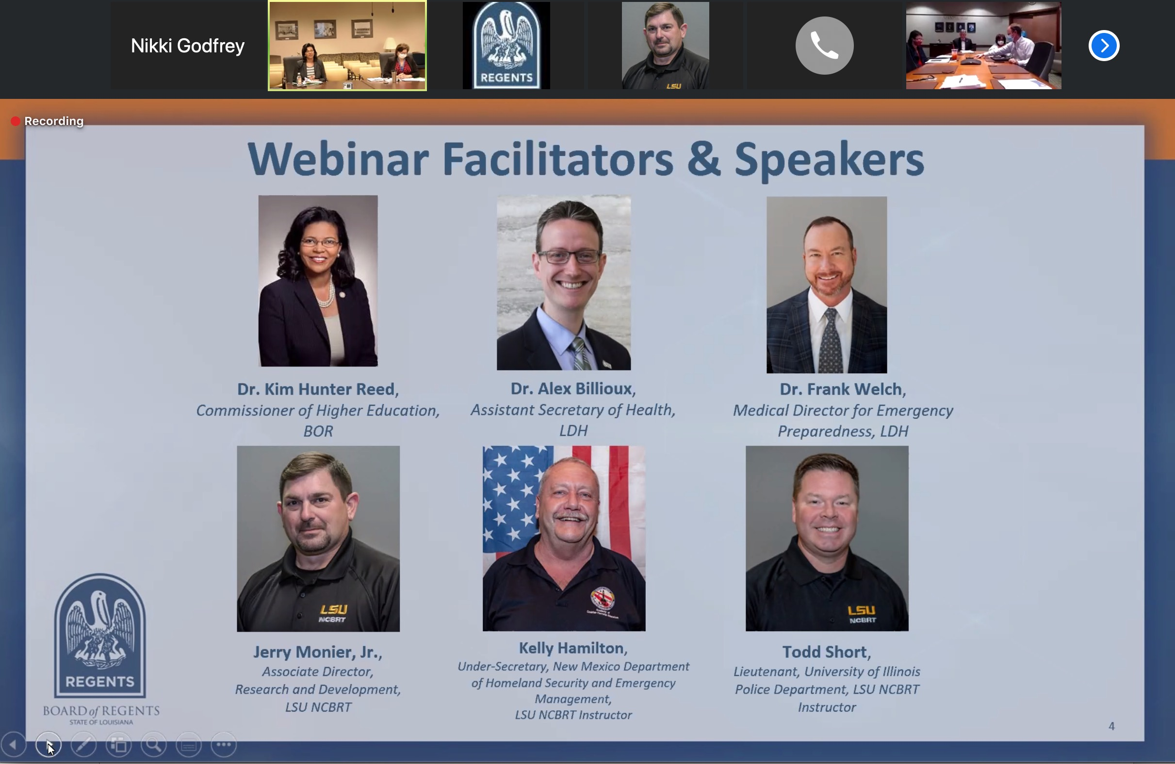
AGENDA ITEM 5.2
Report on Reopening Postsecondary Education
Developed statewide guidance for higher education in partnership with Louisiana Department of Health (LDH) to support ongoing efforts to reopen safely.
Hosted five statewide webinars in partnership with LDH to provide an overview of all issued guidance, as well as respond directly to questions from institutions.
Provided COVID-19 outbreak response scenario webinars for all institutions to test reopening safely plans.
All guidance and webinar presentations located at:
https://regents.la.gov/higher-education-reopening-safely-guidance/

Slide 3
AGENDA ITEM 5.2
Digital Inclusion Report
Spring 2020 – Shifted to 100% online course delivery
Challenge – Lack of Connectivity for All Students
Created Digital Inclusion Committee and Strategic Action Team – system chief academic officers and technology specialists, LAICU leadership, and the eLearning Task Force
Collected Data from Multiple Surveys:
- Identify hardware needs as of April 2020
- Measure student engagement in Learning Management Systems in April & June 2020
Reviewed Statewide Student Withdrawal Data from Spring 2020:
- Gender
- Race Ethnicity

Slide 4
AGENDA ITEM 5.2
Digital Inclusion Report – Withdrawal Data 2019 & 2020
3%
Withdrawal
3,310
1,980
496 more females than 2019
445 more males than 2019
5,290 students withdrew from public institutions in Spring 2020 -
941 more than in 2019.
2-Yr.
4-Yr.
More African American students withdrew from 2-year institutions; more white students withdrew from 4-year institutions.
3,318
1,972
259 more students withdrew
682 more students withdrew

Slide 5
AGENDA ITEM 5.2
Digital Inclusion Report – Professional Devel. Support
Governor Edwards has designated more than $15 million of GEER CARES Act funds to meet the needs of postsecondary students.
Using $500,000 of GEER funding, the Board of Regents LOUIS team and each system developed a comprehensive plan to meet digital literacy and professional development needs for more than 3,300 students, faculty and staff.
Northstar Services and Digital Literacy Training at more than 47 library sites in the State of Louisiana, including LAICU institutions
Two-part process:
Systemwide training series for more than 750 faculty
A cohort approach to effectively design online courses for 3 cohorts of 30 faculty members each

Slide 6
AGENDA ITEM 5.2
Digital Inclusion Report – Professional Devel. Support
Trained more than 1,100 faculty through in-person and remote sessions on teaching effective course management with a focus on course design and alignment.
Created master template for all online courses and paired instructional designers with online faculty subject-matter experts to facilitate training in course design.
Issued 634 certificates in various trainings, with 497 unduplicated faculty trained.
Developed a robust “Bridging the Divide” professional development series with four tracks of training for hundreds of faculty system-wide.
Offered 65 professional development courses serving over 524 learners to date; the final course offering in August has enrolled an additional 437 participants.

Slide 7
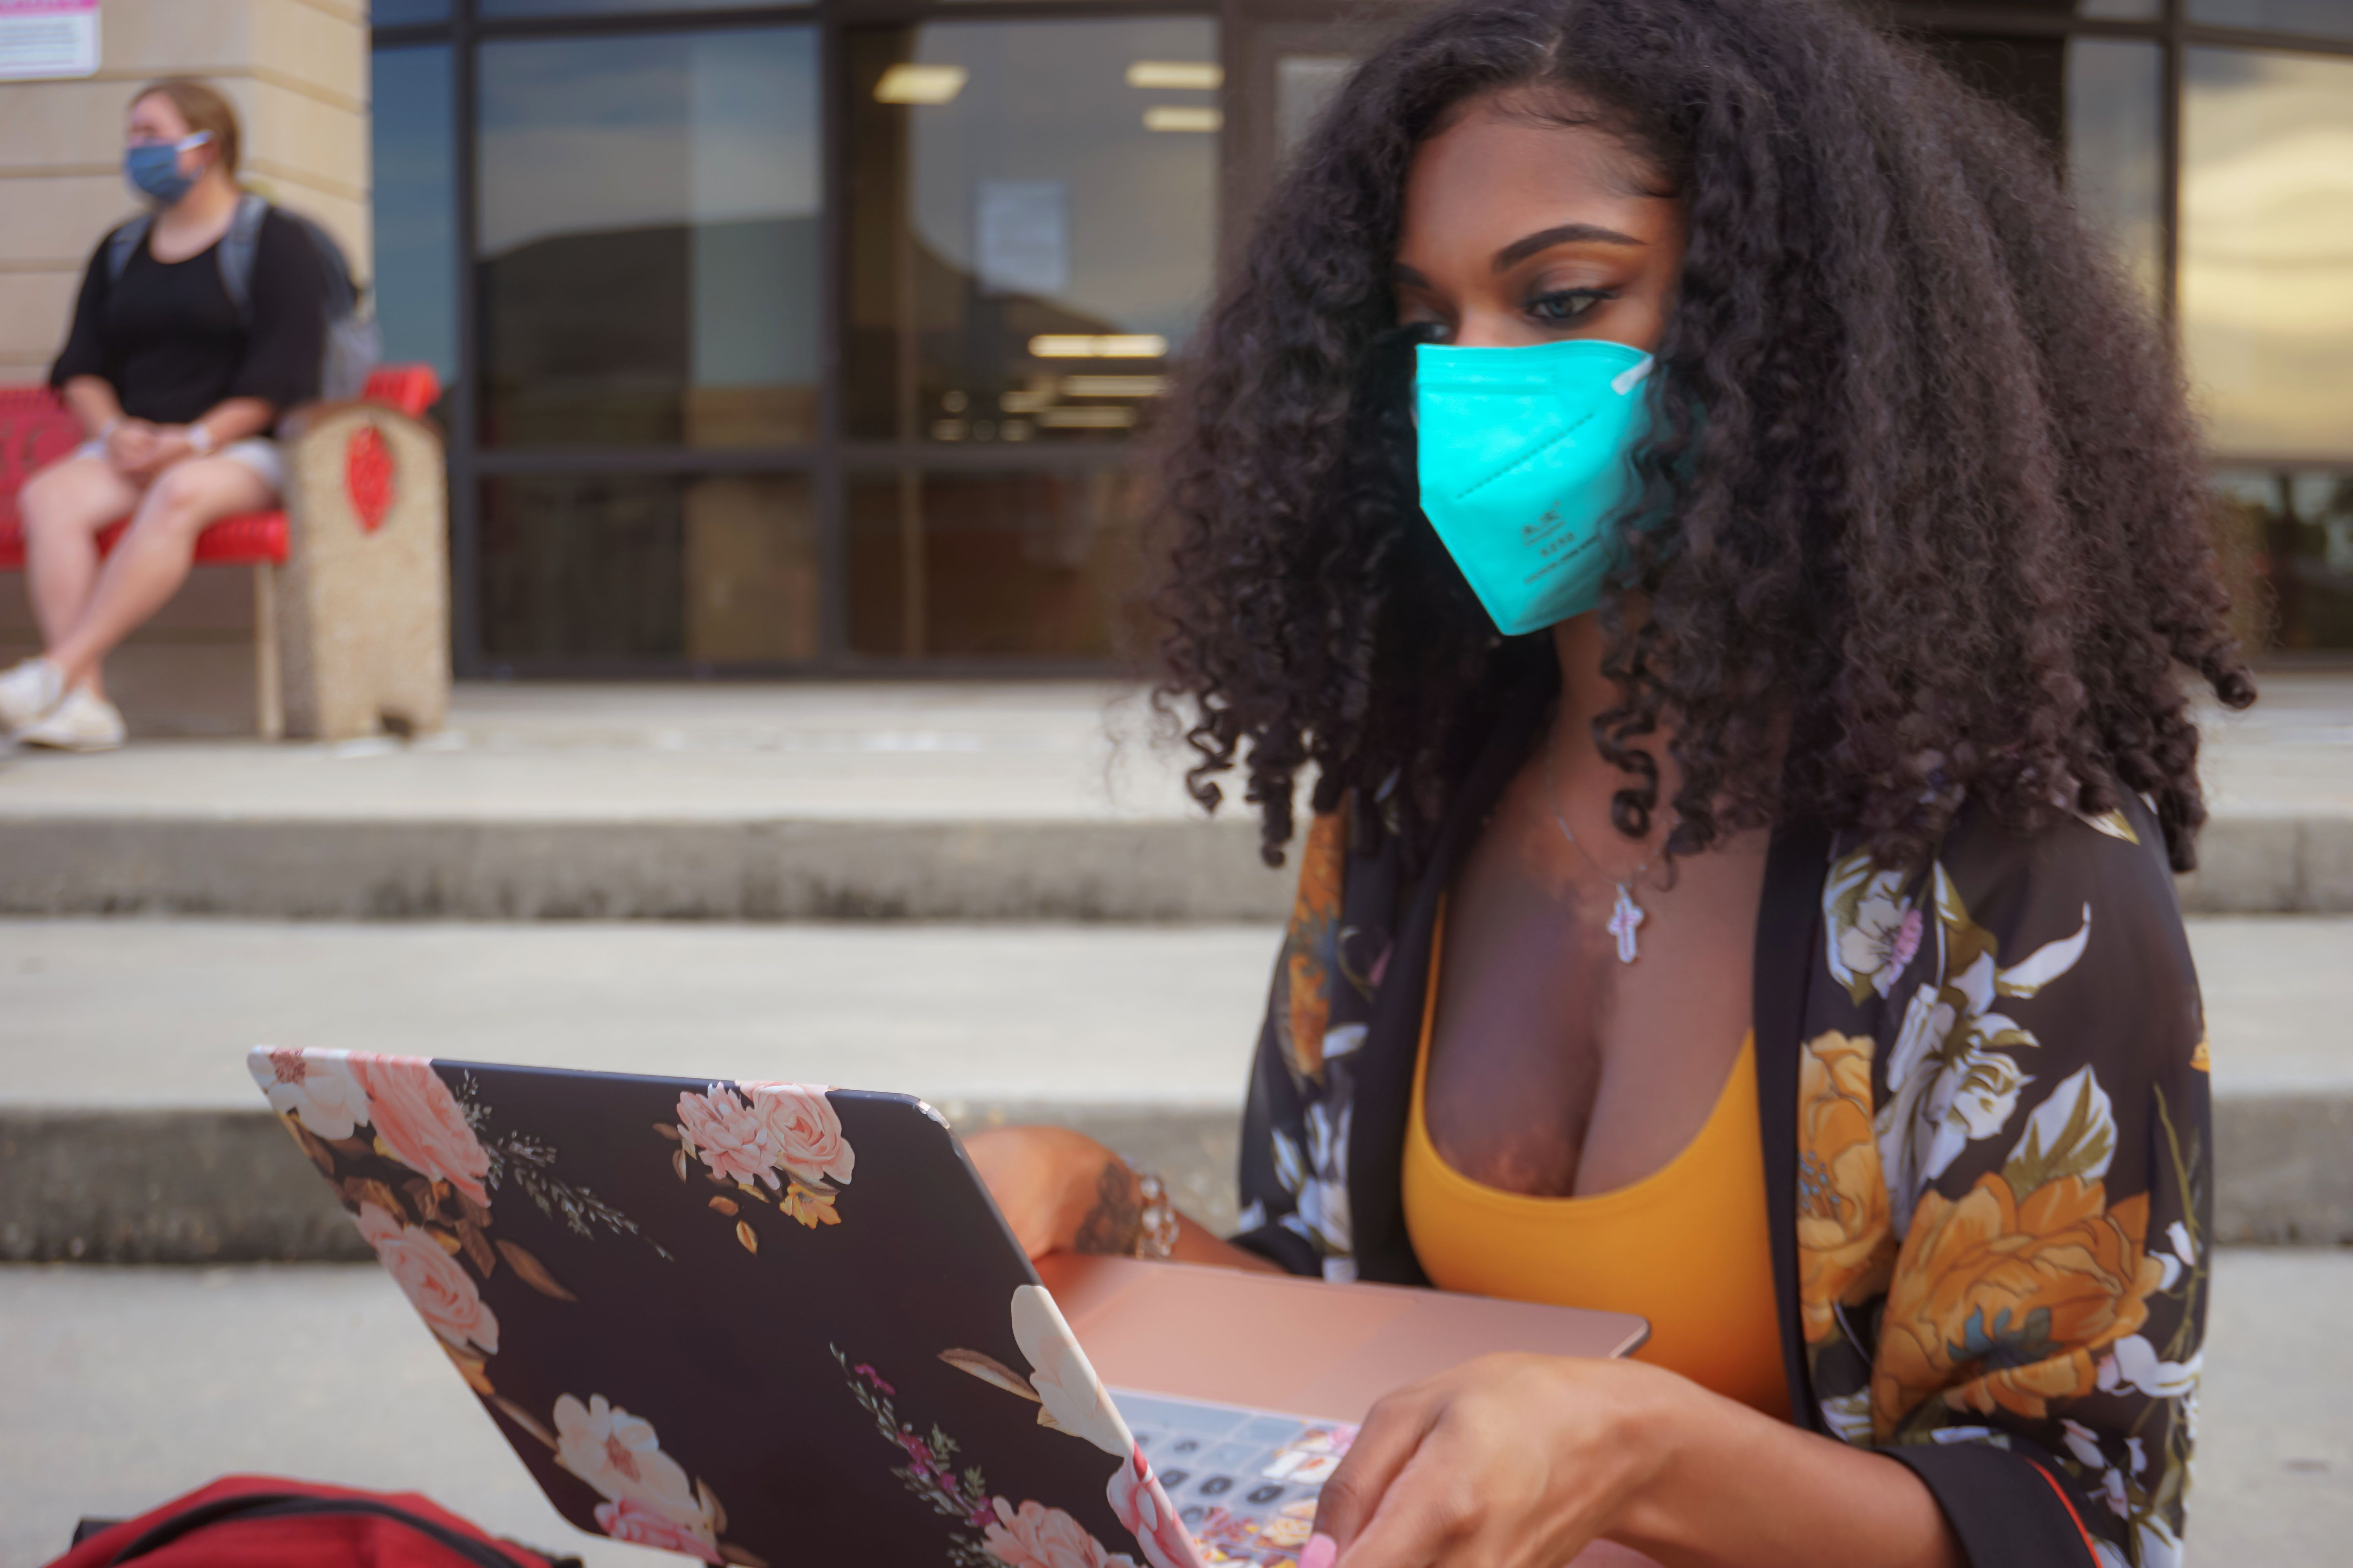
AGENDA ITEM 5.2
Digital Inclusion Report – Device Support
The DOA/BOR Laptop Program distributed 1,200 new laptops to the four public systems to support student needs
$4.5 million in GEER funds distributed to systems for purchase of devices using reduced-cost hardware contracts:
- LCTC System: $1,260,773.30
- LSU System: $1,073,874.43
- Southern System: $274,532.04
- UL System: $1,896,692.24

Slide 8
AGENDA ITEM 5.3
Consideration of an update report
regarding Dual Enrollment

Slide 9
AGENDA ITEM 5.3
Dual Enrollment (DE) Task Force
Created by Act 128 of 2019 Legislative Session
DE Task Force Action to Date:
Interim Report submitted to Louisiana Legislature February 2020
Act 204 of 2020 Legislative Session by Rep. Brass
- Codifies the 8 Guiding Principles necessary to guide dual enrollment access and capacity-building to develop statewide opportunities
- Creates the Dual Enrollment Innovation and Equity Grant to build capacity of dual enrollment programs throughout the state

Slide 10
AGENDA ITEM 5.3
Governor’s Emergency Education Relief (GEER) Funds
$250,000 of GEER funds have been allocated to create a statewide dual enrollment portal
Central location for outreach and engagement materials for parents, students, and counselors concerning dual enrollment

Slide 11
AGENDA ITEM 5.3
Dual Enrollment (DE) Next Steps
Submit Dual Enrollment Recommendations in Response to COVID-19 to Legislature (October)
Develop and implement Dual Enrollment Online Portal for students, parents, counselors, and faculty
Promote dual enrollment as both academic and technical courses
Continue partnership with LDOE/BESE for Dual Enrollment Policies
Present Dual Enrollment Annual Report (January)

