Slide 1
Guiding Students to a Successful Future
Louisiana Transfer Degree

Slide 2
ACT 356
Goal of the Legislation
To eliminate barriers that prevent students from successfully transferring between and among secondary and postsecondary institutions.
Notes:
2

Slide 3
Louisiana Transfer Degree
Guaranteed Transfer of 60 Hours from Community College to University
Guaranteed Completion of the General Education Block
Upon Completion of a Set Curriculum to earn …
Associate of Arts/LA Transfer (AALT)
Associate of Science/LA Transfer (ASLT)

Slide 4
Louisiana Transfer Degree
Automatic Junior Status at Public Universities
Compete with Native Students for Limited Access Programs

Slide 5
Louisiana Transfer Degree
60 Hour Components
39 Hours General Education
21 Hours Related to Major
Curriculum
Follow Concentration Template, and Graduate
Grades
“C” or above
Admission Requirements
Meet University’s GPA

Slide 6
Louisiana Transfer Degree
39 Hours General Education
Block Transfer
Curriculum Options for Concentrations in:
Humanities
Natural Sciences – Biological or Physical
Social/Behavioral Sciences
Fine Arts

Slide 7
What is NOT Guaranteed?
Admission to Every 4-Year University
Public Universities in LA are Participating
Admission to Every Degree Program
Courses for Specific Majors
Some Programs Have Specific Admission Requirements
Not Automatically Satisfied
Transfer admission GPA standards differ, but LT graduate can expect special consideration.

Slide 8
TDG … A Pathway for Success
“2 Degrees…One Good Life”
Earn 2 Degrees in Same Time Frame
Saves Tuition $$$
Community Colleges are Open Admission
If Stop after 2 Years -- Have a Marketable Associate Degree
Take that Associate Degree to a University: earn a Bachelor’s Degree (or higher)

Slide 9
2010-11 – First Year Offered
LT Majors & Graduates – Spring 2011
 | Majors |  | Graduates
 | AALT | ASLT | AALT | ASLT
BPCC | 4 | 3
BRCC | 2
DCC | 75 | 219 |  | 3
LDCC | 32 | 69 |  | 3
NUNEZ | 38 | 48 | 1 | 2
RPCC | 5 | 15 |  | 1
SLCC | 11 | 6 | 1
Total | 177 | 369 | 2 | 9
Year 1: 546 Majors; 11 Graduates

Slide 10
TDG…More Information
www.latransferdegree.org
Check it Out!
Links to Colleges/Universities
Transfer Course List
Curriculum Templates
Advisors Guide

Slide 11
Front Page

Slide 14
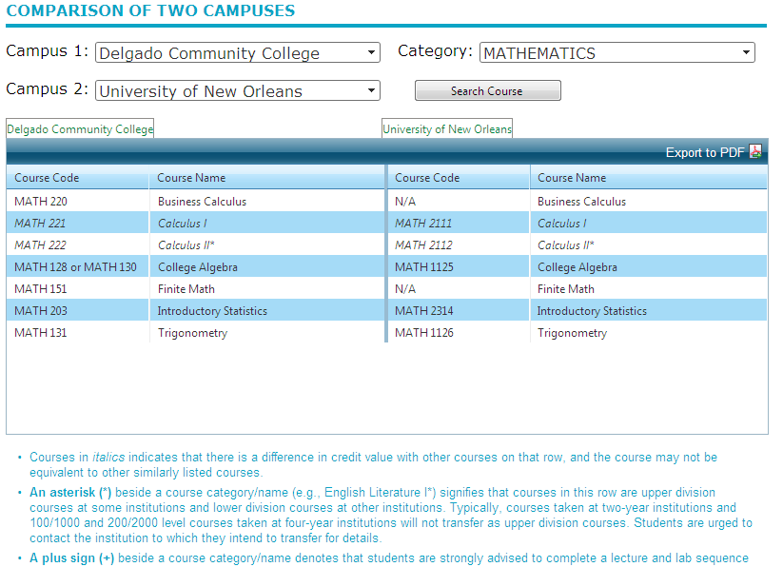
Articulation Matrix = Transfer Course Guide

Slide 15
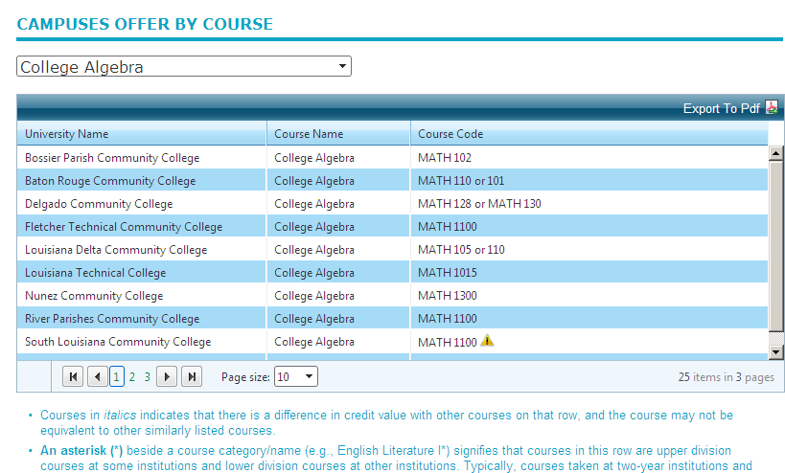
Articulation Matrix = Transfer Course Guide

Slide 17
LT - Curriculum Planning Templates
 |  | HUMANITIES Concentration: (General)
 |  |  | Campus
 |  |  | English (6 GE)
English Comp I--3
English Comp II/ Adv English Comp--3
 |  |  | Math/Analytical Reasoning (6 GE)
College Algebra--3
GenEd Math Elective--3
 |  |  | Natural Sciences (9-10 w/9 GE)
Sequence in Biological or Physical Sciences--6
Lecture in Area Opposite of Sequence--3
Lab to Augment One of the Above Science Lectures--0-1

Slide 18
LT - Curriculum Planning Templates
 |  |  | Humanities (24-30 Hours = 9 GenEd + 15-21)
* GE Literature (3 Hours)
History Sequence or Humanities (6 Hours)
Foreign Language Sequence (9 - 14 Hours)
Humanities Electives (6 - 12 Hours)
 |  |  | Social/Behavioral Sciences (6-12 Hrs = 6 GenEd + 0-6)
Social Science (3 Hours)
Social Science 2000 or (3 Hours)
Social/Behavioral Science Elective(0-6 Hours)
 |  |  | Fine Arts (3 Hours: GenEd)
Fine Arts (3 Hours)
Notes (e.g., Program Admission):
* Check catalog of transfer institution for specific course recommendations, depending on anticipated major.
Completion of the AALT/ASLT degree guarantees that the student has met, in full, all lower division general education requirements at the receiving Louisiana public university. Graduates transferring with the transfer degree will have junior status. Courses or GPA requirements for specific majors, departments, or schools are not automatically satisfied by an AALT/ASLT degree.

Slide 19
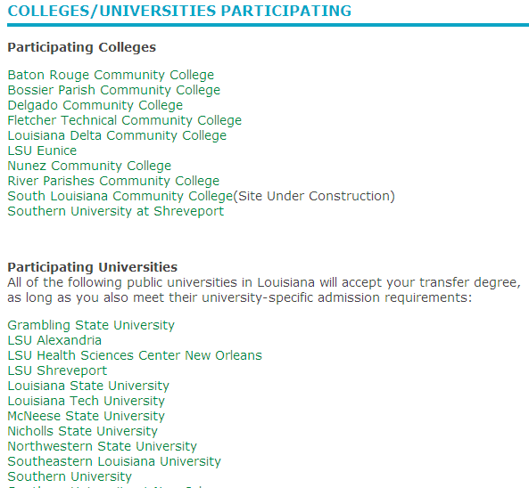
Schools Participating

Slide 20
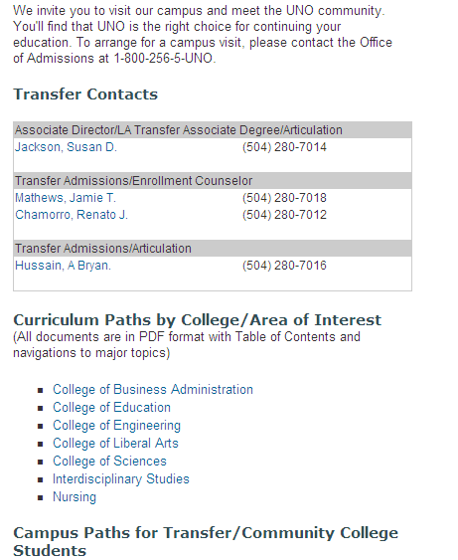
UNO

Slide 22
Addendum…TDG Summary (1)
Completion of the Louisiana Transfer Associate Degree (AALT, ASLT) guarantees that the student has met, in full, all lower division general education requirements at the receiving Louisiana public university.

Slide 23
Addendum…TDG Summary (2)
Graduates transferring with the transfer degree will have junior status. Courses or GPA requirements for specific majors, departments, or schools are not automatically satisfied by an AALT/ASLT degree.

Slide 24
http://LaTransferDegree.org/
** Check It Out **

